Slide 1
Smart irrigation system using the internet of things
Presented by
Name
institution

Slide 2
Introduction
Digitalization has revolutionized the way people carry out various Agricultural activities.
The current generation is on top of things in embracing technology to carry out different farming activities.
The adoption of smart technologies to carry out irrigation has contributed to bring about efficiency that boosts the ability as well as aid in minimization of the associated costs.

Slide 3
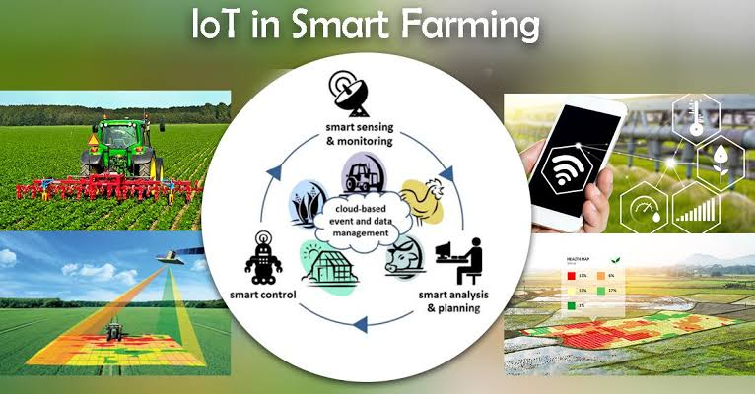
Framework of smart irrigation

Slide 4
Benefits of smart irrigation
The are various benefits accrued as a result of smart irrigation.
It saves on money through the reduction in the water waste
It enhances landscape health and beauty
Helps an individual to prepare for the future of the water
It enables people to control the decrease the hardscape loss
It avoid fines with the smart irrigation controller.

Slide 5
Demerits of smart technology
There are disadvantages of smart technology
Cost of initial installation
To set up a smart irrigation technology requires investment of huge amounts of money that may be a barrier to small scale farmers. This would only be realistic to large scale farmers who are able to finance themselves.
The farmers are required to have a buffer amount of money which they can use for investing in this kind of project.
The initial capital outlay increases the operational costs which eats on the expected projects.

Slide 6
Demerits
Reliability
The most important aspect of every project one is planning to undertake is whether people can rely on it for long.
Majority of people have doubts on whether the smart technology would sort out the challenges they are experiencing in their farming activities.
The smart technology can only be 100 percent filly reliable because it requires power connectivity which might experience blackouts hence not serve adequately intended purposes.

Slide 7
Demerits cont.…
Increases channel maintenance
Introduction of the smart technology in our farms is provides an avenue for the farmers to monitor the progress of their farming activities remotely. However, this adoption comes with an increase in channel maintenance that requires a skilled human resources.
The devices set up also require regular serving and replacement of the warn out machines. Consequently, this doubles the degree of maintenance from the human resource and machine perspective.

Slide 8
Types of smart irrigation systems
The main types of smart irrigation techninques are
Self watering vertical planter
Irrigation drop by drop
Capilarry injection

Slide 9
Self watering vertical planter
The vertical planter incorporates an automatic recircular irrigation system.
It is based on the premise of biometric self irrigation since ot copy the water cycle in nature.
The planter’s base is adopted as the water tank.
There is water pump that is highly programmed incorporating timer details and freely allowed to raise the water to the top.
Moreover, there are mesh pots are incporporated to permit the irrigation water move in different pots hence watering the plants in along the water path.
Since there are excess water, it is collected again in the tank for reusing during the next irrigation period.
This Smart irrigation method ensures that over 50 percent of the water as well as the minerals are saved.

Slide 10
Operationalization of the self irrigation vertical planter
A digital timer or WIFI timer may be used in programming the re-circular irrigation. Therefore, it is capable of addressing the

Slide 11
References
Koduru, S., Padala, V. P. R., & Padala, P. (2019). Smart irrigation system using cloud and Internet of Things. In Proceedings of 2nd international conference on communication, computing and networking (pp. 195-203). Springer, Singapore.
Krishnan, R. S., Julie, E. G., Robinson, Y. H., Raja, S., Kumar, R., & Thong, P. H. (2020). Fuzzy Logic based Smart Irrigation System using Internet of Things. Journal of Cleaner Production, 252, 119902.
Leh, N. A. M., Kamaldin, M. S. A. M., Muhammad, Z., & Kamarzaman, N. A. (2019, October). Smart Irrigation System Using Internet of Things. In 2019 IEEE 9th International Conference on System Engineering and Technology (ICSET) (pp. 96-101). IEEE.
Saraf, S. B., & Gawali, D. H. (2017, May). IoT based smart irrigation monitoring and controlling system. In 2017 2nd IEEE International Conference on Recent Trends in Electronics, Information & Communication Technology (RTEICT) (pp. 815-819). IEEE.

